Slide 1
Compilation Overview
Apan Qasem
CS 4318/5531
Texas State University
*some slides adopted from Cooper and Torczon

Slide 2
The Compiler’s Tasks
Source
Compiler
Machine
code
Code
C
C++
Java
Python
Lisp
x86
MIPS
Sparc
Power
Errors
Implications
  Must recognize legal (and illegal) programs
  Must generate correct code
  Must manage storage of all variables (and code)
  Must agree with OS & linker on format for object code
These tasks are non-trivial!

Slide 3

Abstraction Layers in Computer Systems
Problem
Use Computer to Solve Problem
Lot of things going on
Notes:
CS252 S05

Slide 4
Abstraction Layers in Modern Systems
Application
Problem
Algorithm
Programming Language
Operating System/Compilers
Instruction Set Architecture (ISA)
Microarchitecture
Gates/RTL
Circuits/Devices
Physics
Notes:
CS252 S05

Slide 5
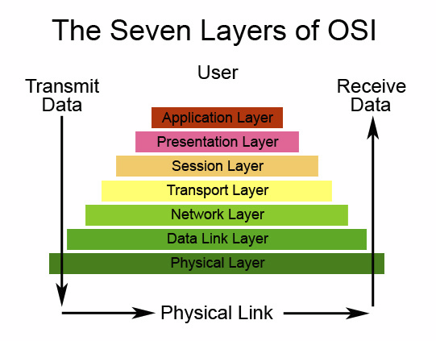
Network Layers

Slide 6
High-level View of a Compiler
Source
Compiler
Machine
code
Code
C
C++
Java
Python
Lisp
x86
MIPS
Sparc
Power
Errors
The complexity of the tasks dictates multiple layers of abstraction at the
source-code level

Slide 7
Structure of a Compiler
The task of compilation is broken-up into several phases
  Abstraction!
  Think about the OSI network layers
Strong theoretical foundation for several phases
  Some problems are a natural fit for areas in computation and language theory
The structure of a compiler reflects this break-up
  Almost all modern compilers consist of multiple components, each performing a part of the bigger task
  These components are sometimes referred to as passes or modules or phases
  A particular phase may perform a task independent of other phases but usually these tasks cannot be done in parallel
    Each phase of a compiler builds on the result produced by the previous stage

Slide 8
Traditional Two-pass Compiler
Source
Front End
IR
Back End
Machine
code
code
Errors
Implications
  Use an intermediate representation (IR)
    Analogy holds for problem solving in CS
  Front end maps legal source code into IR
  Back end maps IR into target machine code
Typically, front end is O(n) or O(n log n), while back end is NPC

Slide 9
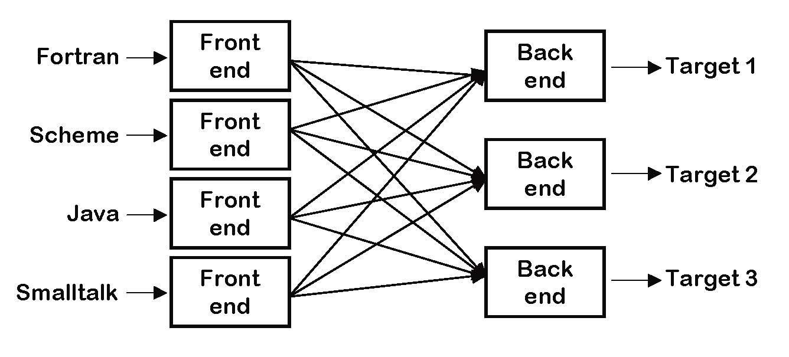
Importance of IR
  Don’t need to write a full-blown compiler for every high-level language
  Don’t need to write a full-blown compiler for every platform
  Still cumbersome if IR is not consistent

Slide 10
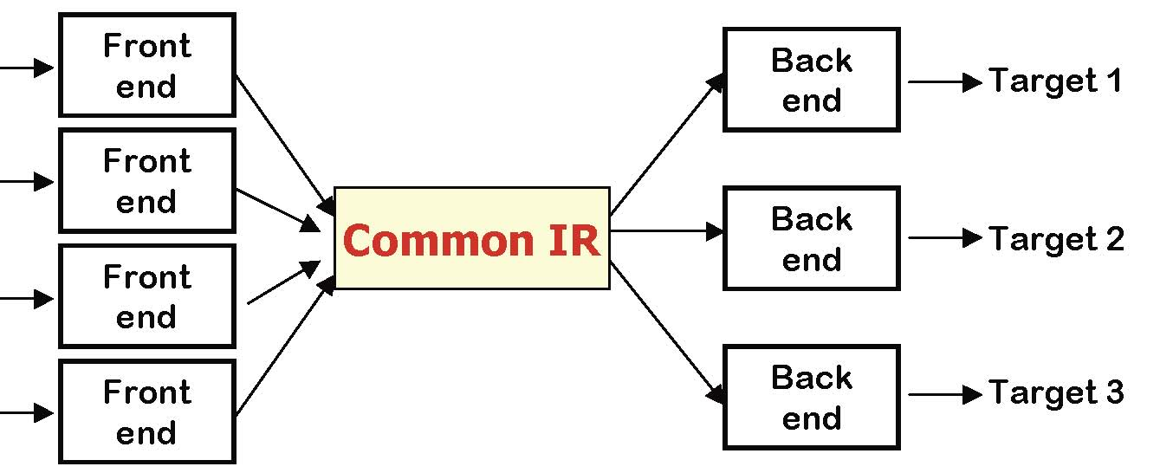
A Common IR
Fortran
C++
Java
Python
Must encode all language specific knowledge in each front end
Must encode all target specific knowledge in each back end
IR should be general enough to accommodate each front end and back end
Many production compilers use this strategy: HP, IBM, Intel, gcc
Attempts have been made to unify IR for all compilers
  OpenAnalysis, Open64
  Not that successful!

Slide 11
The Front End
Source
Scanner
tokens
Parser
IR
code
Errors
Responsibilities
  Recognize legal (& illegal) programs
  Report errors in a useful way
  Produce IR & preliminary storage map
  Shape the code for the rest of the compiler
  Much of front end construction can be automated

Slide 12
The Front End
Source
Scanner
tokens
Parser
IR
code
Errors
Input : stream of characters and token rules (regular expressions)
Output: a set of tokens
Identifies words within the character stream and type of each word
A token is a <word, type> pair
What might some tokens for a typical high-level language?
  <17, number>
  <foo, identifier>
  <+, operator>
  <while, keyword>

Slide 13
The Front End
Source
Scanner
tokens
Parser
IR
code
Errors
English language analogy
thisisasentence ==> thisisasentence
sentencethisais ==> sentencethisais
What about?
maintainhis

Slide 14
The Front End
Source
Scanner
tokens
Parser
IR
code
Errors
Few errors detected at this stage
  illegal identifier
  mismatched parentheses
Speed is important
We will use an automatic scanner generator for our compiler
Some commercial scanners appear to be hand-coded

Slide 15
The Front End
Source
Scanner
tokens
Parser
IR
code
Errors
Input : stream of tokens and a grammar
Output : IR for next phase
Grammar specifies syntax of the language
  all syntax errors are detected at this stage
Guides analysis in later phases
  context-sensitive or semantic analysis : e.g., type checking
We will use an automatic parser generator for our compiler
Some commercial parsers appear to be hand-coded

Slide 16
The Front End
Source
Scanner
tokens
Parser
IR
code
Errors
English language analogy
this is a valid sentence ==> this is a valid sentence
bat boy ball car ==> ?

Slide 17
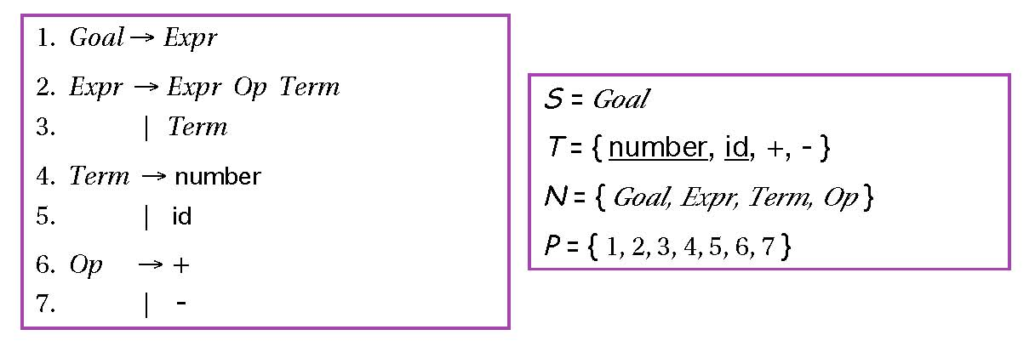
Context-free Grammar
This grammar defines simple expressions with addition and subtraction over number and id
The notation used is a variant of BNF (Backus-Naur Form)
This grammar like many falls in a class called context-free grammar
Most programming languages can be expressed using CFGs

Slide 18
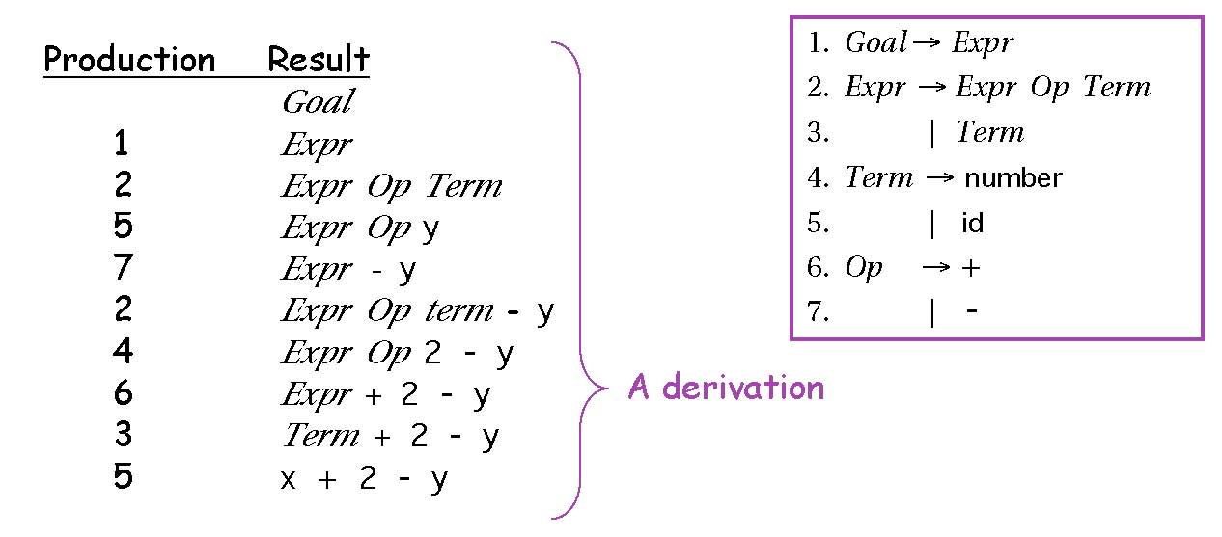
Parsing for CFGs
We can derive sentences in this language by repetitive substitution
  This process is called derivation
We reverse the process to determine if a sentence is legal
  This process is called parsing

Slide 19
Semantic Analysis
Source
Scanner
tokens
Parser
IR
Semantic
Analysis
IR
code
Errors
Input : IR
Output : IR for backend
Checks if the program “means” anything
  Not correctness of program!
This phase lies at the intersection of the front-end and back-end
  Technically, it should be in the front-end (i.e. don’t want to generate code for or optimize meaningless programs)

Slide 20
Semantic Analysis
Source
Scanner
tokens
Parser
IR
Semantic
Analysis
IR
code
Errors
English language analogy
Jack said Jerry left his assignment at home
Please raise your write hand
In some situations, can make an assumption and move on …

Slide 21
The Back End
Instruction
Selection
Register
Allocation
Instruction
Scheduling
IR
IR
tokens
IR
Machine
code
Errors
Responsibilities
  Translate IR into target machine code
  Choose instructions to implement each IR operation
  Decide which value to keep in registers
  Ensure conformance with system interfaces
Automation has been less successful in the back end

Slide 22
The Back End
IR
Instruction
Selection
IR
Register
Allocation
IR
Instruction
Scheduling
Machine
code
Errors
Instruction Selection
  Produce fast, compact code
  Take advantage of target features such as addressing modes
  Usually viewed as a pattern matching problem
    ad hoc methods, pattern matching, dynamic programming
This was the problem of the future in 1978
    Spurred by transition from PDP-11 to VAX-11
    RISC simplified this problem
What performance parameter does this target?

Slide 23
The Back End
IR
Instruction
Selection
IR
Register
Allocation
IR
Instruction
Scheduling
Machine
code
Errors
Register Allocation
  Have each value in a register when it is used
  Manage a limited set of resources
  Can change instruction choices & insert LOADs & STOREs
  Optimal allocation is NP-Complete (1 or k registers)
Compilers approximate solutions to NP-Complete problems

Slide 24
The Back End
IR
Instruction
Selection
IR
Register
Allocation
IR
Instruction
Scheduling
Machine
code
Errors
Instruction Scheduling
  Avoid hardware stalls and interlocks
    Need to be aware of pipeline mechanism on the target machine
  Use all functional units productively
  Can increase lifetime of variables changing the allocation
    This implies might have to go back to register allocation
Optimal scheduling is NP-Complete in nearly all cases
Heuristic techniques are well developed

Slide 25
Traditional Three-Pass Compiler
Source
Front End
IR
Middle End
IR
Back End
Machine
code
code
Errors
Code Improvement (or Optimization)
  Analyzes IR and rewrites (or transforms) IR
  Primary goal is to reduce running time of the compiled code
    May also improve space, power consumption, …
Must preserve “meaning” of the code
  Measured by values of named variables
  This rule being violated by some compilers that optimize aggressively
  Look at man page for Intel or MIPSPro compilers and read what they say about –O3 level optimizations

Slide 26
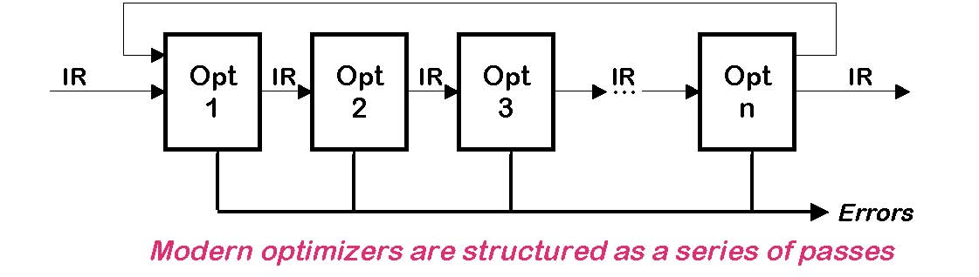
Modern Compilers
Typical Transformations
  Discover and propagate some constant value
  Move a computation to a less frequently executed place
  Discover a redundant computation and remove it
  Remove dead code or unreachable code

Slide 27
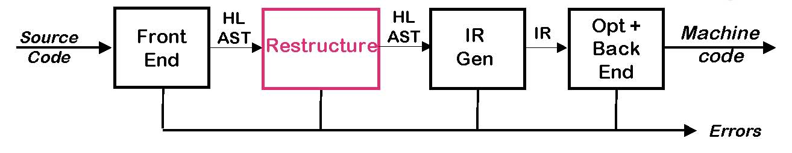
Modern Compilers
Typical Restructuring Transformations
  Blocking for memory hierarchy
  Parallelization
  Vectorization
  Inlining

Slide 28
Runtime System
Responsibilities
  Error checking
  Memory management services
    Allocate
      In the heap or in an activation record (stack frame)
    Deallocate
    Collect garbage
  Run-time type checking
  Interface to the operating system
    Input and output
  Support of parallelism
    Parallel thread initiation
    Communication and synchronization
Strictly speaking the run-time system is not really a part of the compiler. However, the compiler must generate code that performs many of the above tasks

Slide 29
Modern Compilers
So, what compilers are out there?
Open Source
  GCC
  Open64
Commercial
  PathScale
  The Portland Group (PGI)
  Intel
  IBM
  MIPSPro (SGI)
  Microsoft Visual
  Sun Studio
  HP

Slide 30
Summary
Compiler Phases
  Front End
    Scanning
    Parsing
  IR
  Back End
    Instruction Selection
    Register Allocation
    Instruction Scheduling
  Middle End
    Optimizations

Slide 31
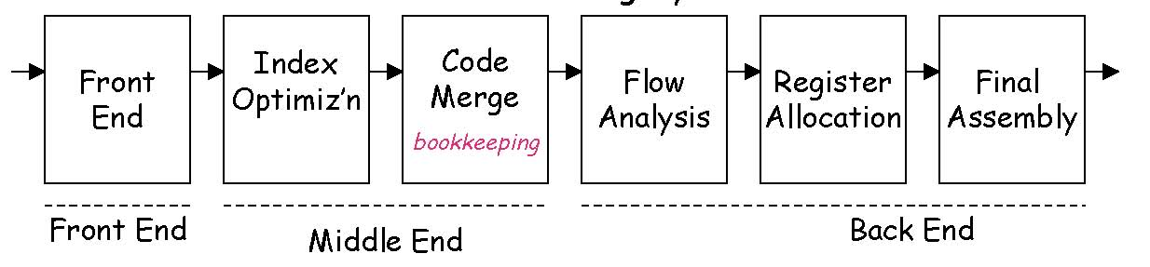
Classic Compilers
1957: The FORTRAN Automatic Coding System
  Six passes in a fixed order
  Generated good code
  Assumed unlimited index registers
  Code motion out of loops, with ifs and gotos
  Did flow analysis & register allocation

Slide 32
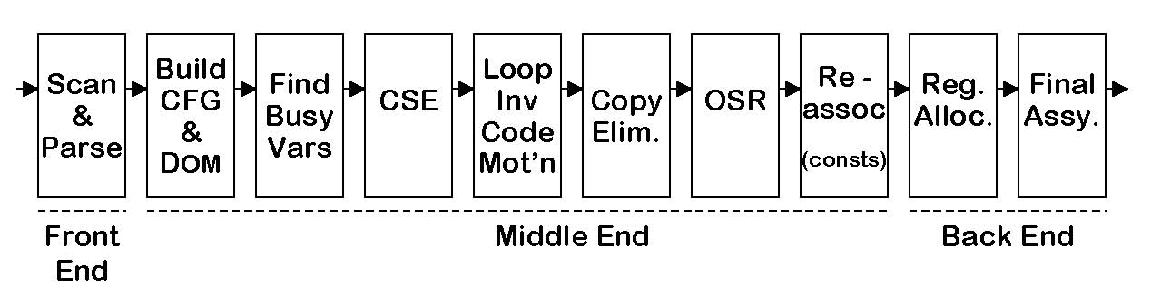
Classic Compilers
1969: IBM’s FORTRAN H Compiler
  Used low-level IR (quads), identified loops with dominators
  Focused on optimizing loops (“inside out” order)
  Passes are familiar today
  Simple front end, simple back end for IBM 370

Slide 33
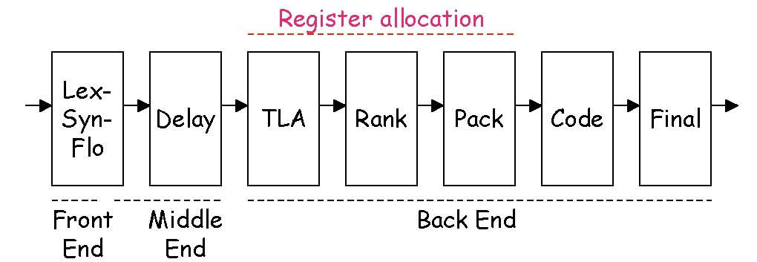
Classic Compilers
1975: BLISS-11 compiler (Wulf et al., CMU)
  The great compiler for the PDP-11
  Seven passes in a fixed order
  Focused on code shape & instruction selection
  LexSynFlo did preliminary flow analysis
  Final included a grab-bag of peephole optimizations

Slide 34
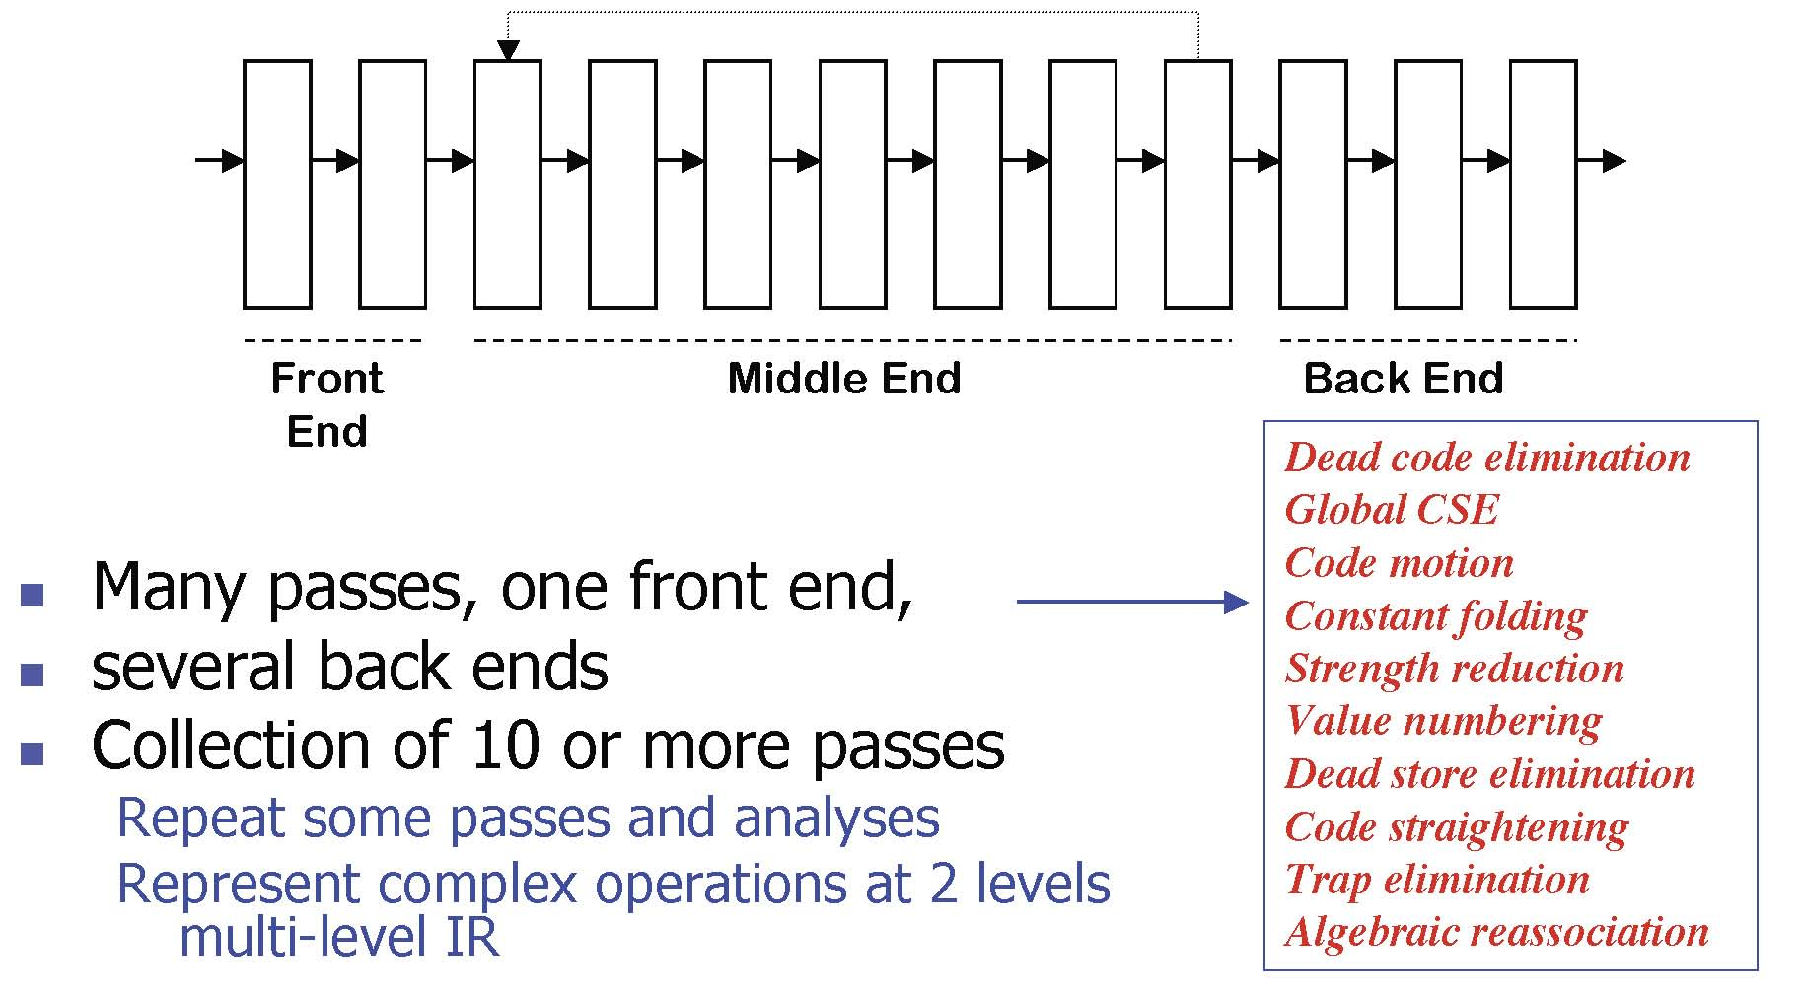
Classic Compilers
1980: IBM’s PL.8 Compiler

Slide 35
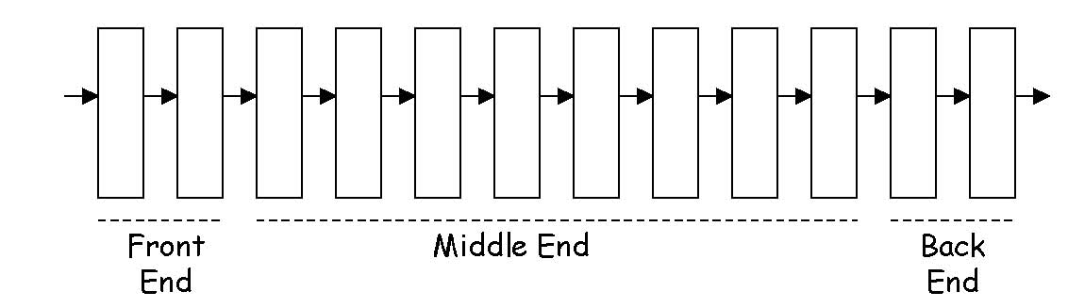
Classic Compilers
1986: HP’s PA-RISC Compiler
  Several front ends, an optimizer, and a back end
  Four fixed-order choices for optimization (9 passes)
  Coloring allocator, instruction scheduler, peephole optimizer

Slide 36
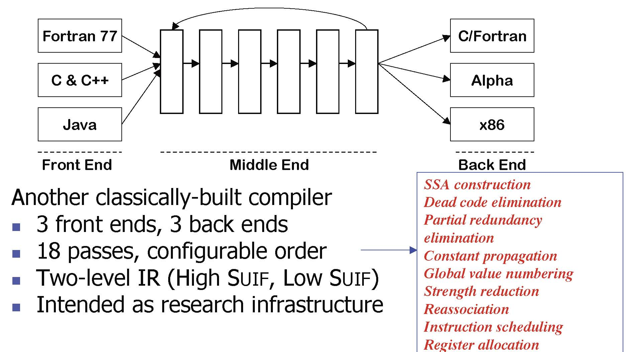
Classic Compilers
1999: The SUIF Compiler System

